Slide 1
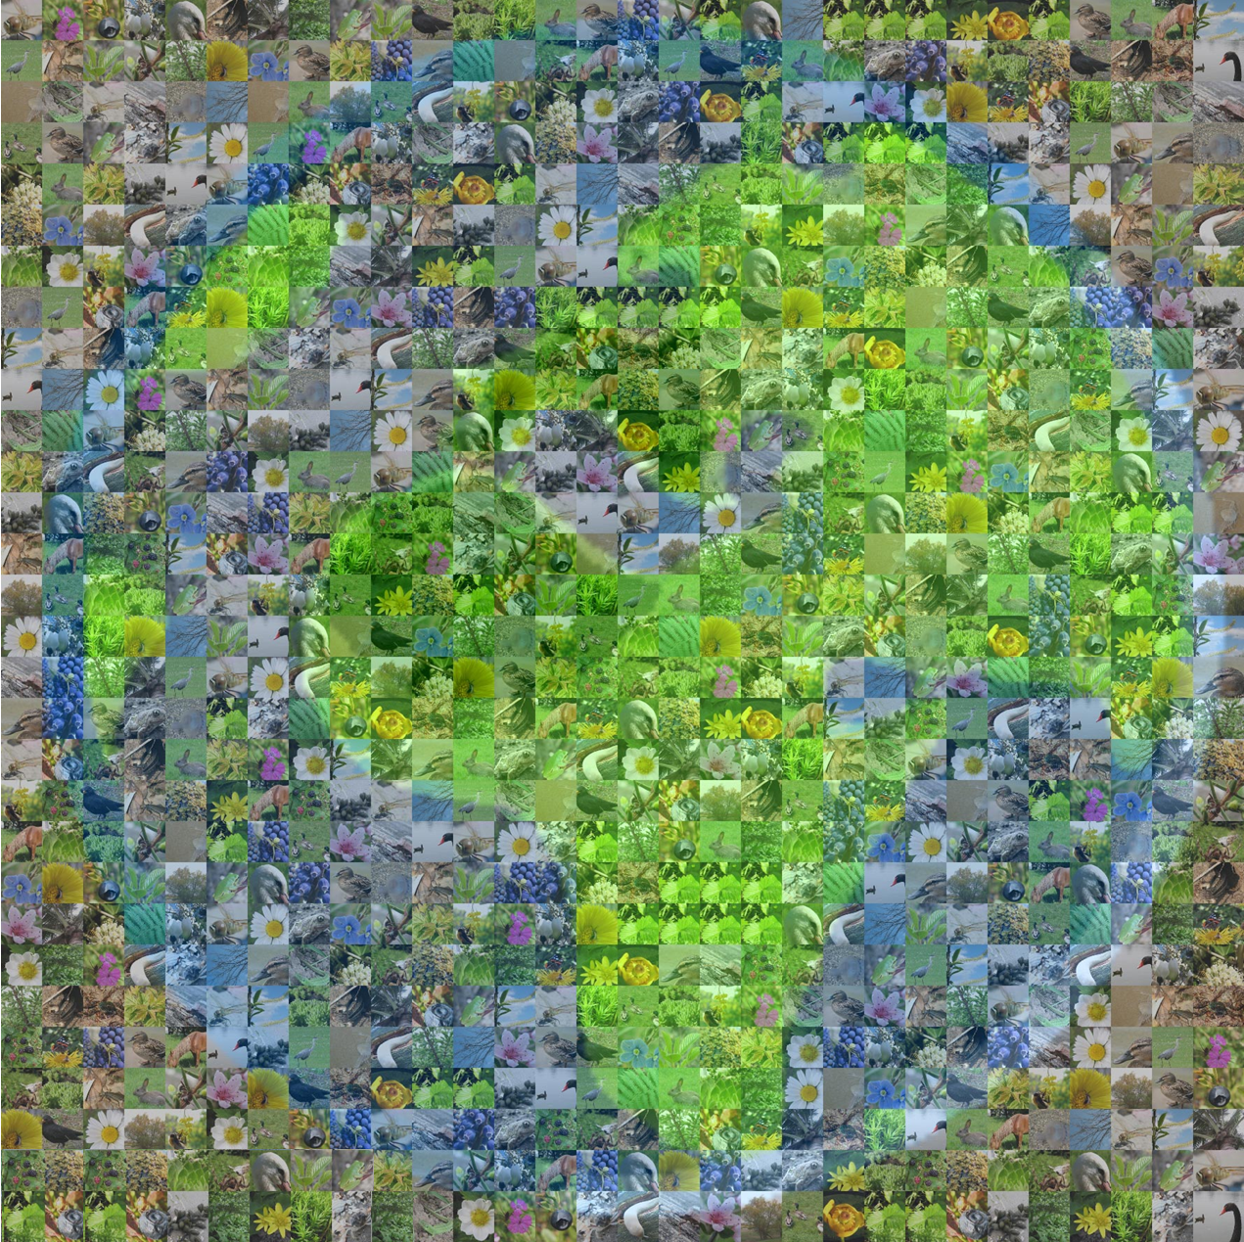
Global patterns and processes of the diversity of life on Earth
What is at stake!!!

Slide 2
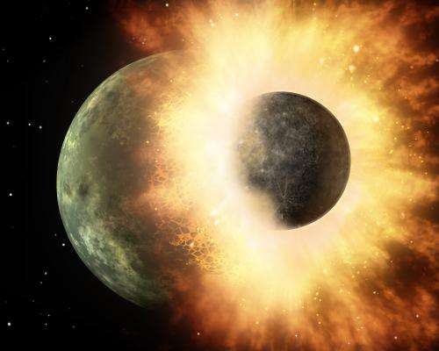
4.6 billion years ago -- Formation of Earth

Slide 3
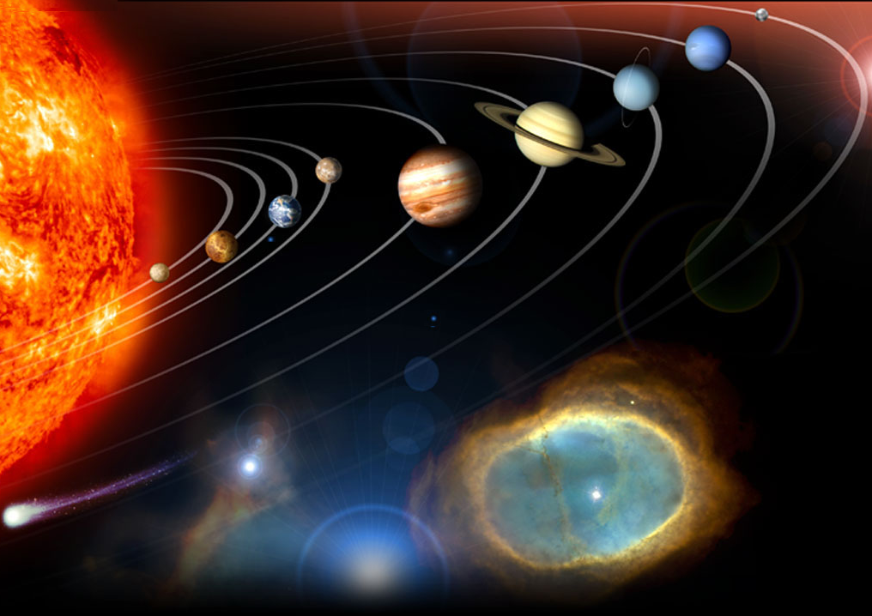
The conditions for life were just right
3. The right distance from the energy source
To cool
To hot
1. Source of constant and stable energy
2. A terrestrial planet
8. Magnetic shield
4. Need a satellite star
5. Near circular orbit
7. Carbon and oxygen
6. The right place in the galaxy
Notes:
Requirements for life
a solar system with a single massive Sun than can serve as a long-lived, stable source of energy
a terrestrial planet (non-gaseous)
the planet must be the right distance from the sun in order to preserve liquid water at the surface – if it’s too close, the water is burnt off in a runaway greenhouse effect, if it’s too far, the water is permanently frozen in a runaway glaciation
the solar system must be placed at the right place in the galaxy – not too near dangerous radiation, or to be absorb by their gravity
a moon of sufficient mass to stabilize the tilt of the planet’s rotation
A near circular orbit to maintain water in its surface
an oxygen-rich atmosphere
a sweeper planet to deflect comets, etc.
planetary neighbors must have non-eccentric orbits to avoid collitions
Carbon for encoding biological information to allow it to replicate itself. The only element in the periodic table that allows you to encode information is carbon.
Oxigen to fuel metabolisms and independence of organinms
http://winteryknight.wordpress.com/2009/04/02/what-conditions-are-needed-to-create-a-habitable-planet/
http://www.arn.org/docs/gonzalez/gg_arewealone.htm

Slide 4
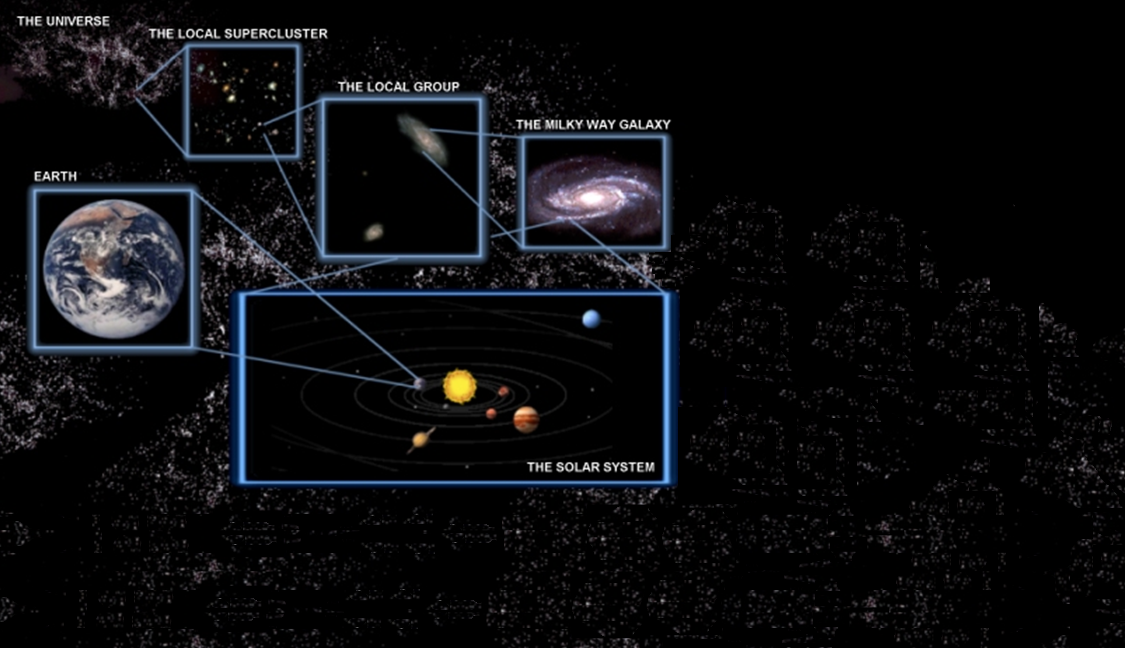
As many as 100 billion earth-like planets
~ 10 meet Earth's life conditions
Probability of another similar planet = ~0.00000000001
Notes:
Thank you very much and have a good day!. And just to clarify, I was being sarcastic with my closing statement.
I am not sayiing this to scare you but I think we should be scare
At the speed of light it would take 100.000 years to go across the milky way, and just going to Mars has been one of the greatest achivement of human exploration of our universe. Then what will be the odds that we can move somewhere else after messing up this planet?

Slide 5
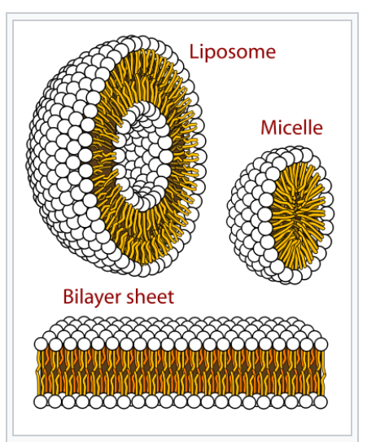
Nearly a billion years later: Protocells
4.6 billion years ago to 3.4 billion years
Storage, self-organized

Slide 6
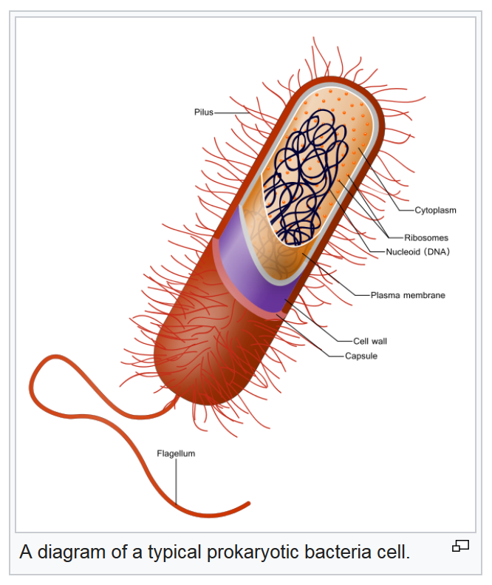
3.4/3.5 billion years ago: Prokariotes
Noffke, Nora; Christian, Daniel; Wacey, David; Hazen, Robert M. (16 November 2013). "Microbially Induced Sedimentary Structures Recording an Ancient Ecosystem in the ca. 3.48 Billion-Year-Old Dresser Formation, Pilbara, Western Australia". Astrobiology. New Rochelle, NY: Mary Ann Liebert, Inc. 13 (12): 1103–1124

Slide 7
Where?
Inukjuak, Quebec (3)
Glazier (1)
Pilbara, Western Australia (2)
1. Schopf, J. William (29 June 2006). "Fossil evidence of Archaean life". Philosophical Transactions of the Royal Society B. London: Royal Society. 361 (1470): 869–885
2. Noffke, Nora; Christian, Daniel; Wacey, David; Hazen, Robert M. (16 November 2013). "Microbially Induced Sedimentary Structures Recording an Ancient Ecosystem in the ca. 3.48 Billion-Year-Old Dresser Formation, Pilbara, Western Australia". Astrobiology. New Rochelle, NY: Mary Ann Liebert, Inc. 13 (12): 1103–1124
3. Dodd, Matthew S.; Papineau, Dominic; Grenne, Tor; Slack, John F.; Rittner, Martin; Pirajno, Franco; O'Neil, Jonathan; Little, Crispin T. S. (1 March 2017). "Evidence for early life in Earth’s oldest hydrothermal vent precipitates". Nature. 543: 60–64
Schopf, J. William (29 June 2006). "Fossil evidence of Archaean life". Philosophical Transactions of the Royal Society B. London: Royal Society. 361 (1470): 869–885

Slide 8
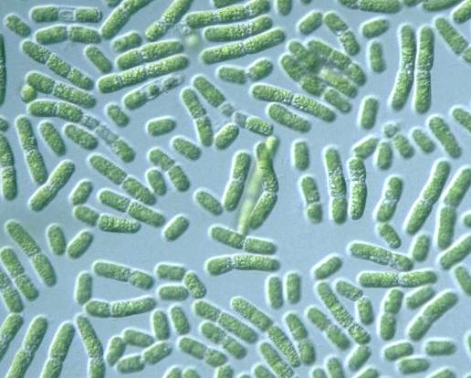
2.7 billion years ago: Cyanobacteria-prokaryotes
These ubiquitous bacteria were the first oxygen producers. They absorb visible light using a mix of pigments: phyco­bilins, carotenoids and several forms of chlorophyll.

Slide 9
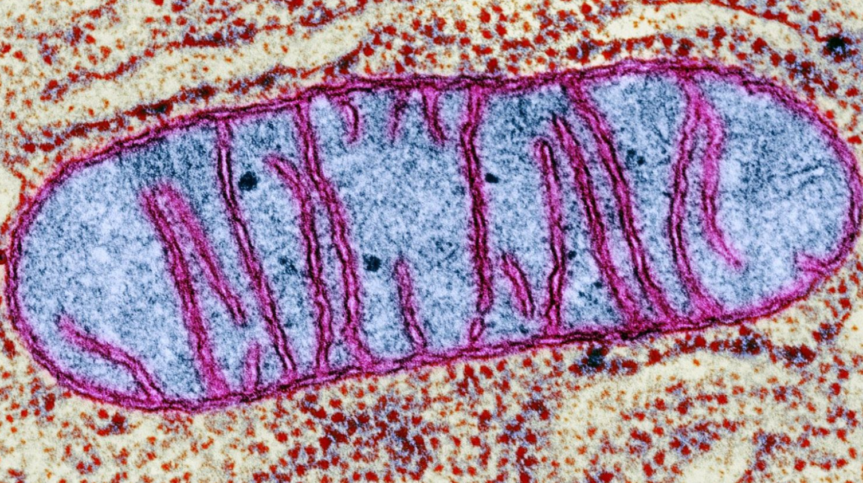
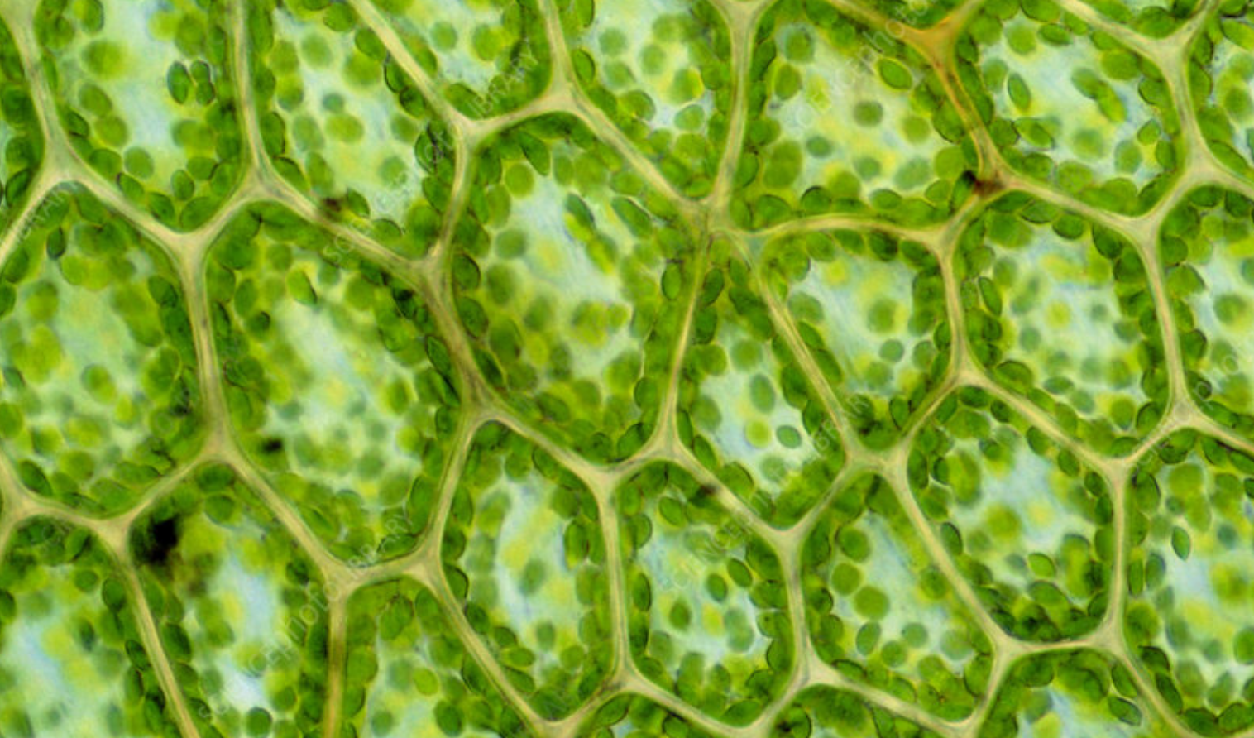
Prokaryote/bacteria
Energy via
Energy via
Oxygen
Sunlight
Mitochondria
Chloroplast

Slide 10
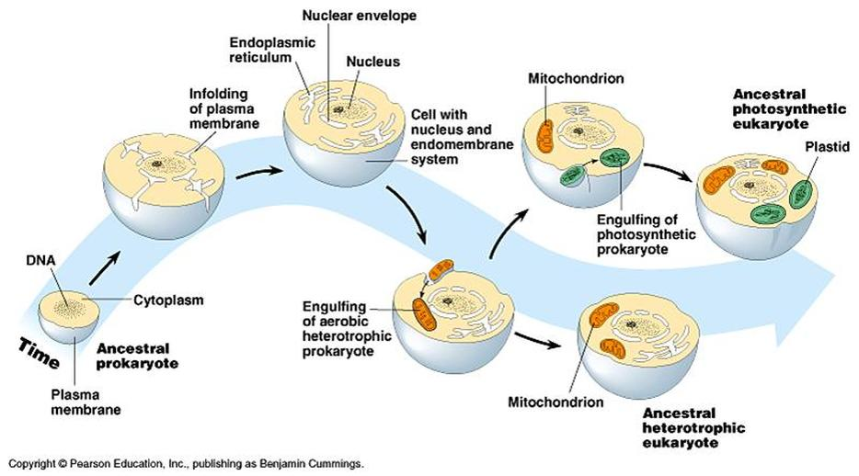
2.1 billion years ago: Eukaryotes
Endosymbiont theory
MILLION
OF
SPECIES
EVOLUTION

Slide 11
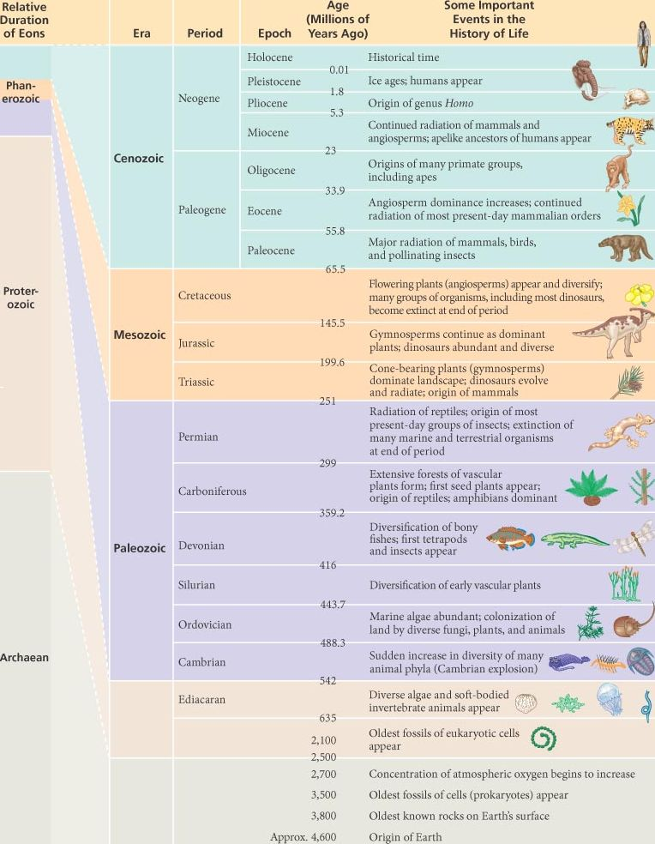
General time line

Slide 12
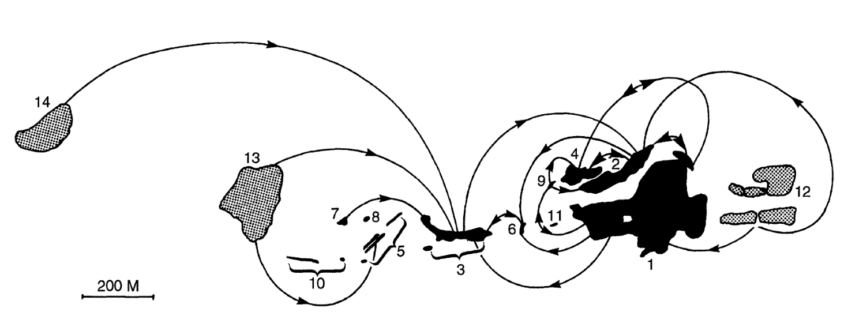
Species originate, disperse and go extinct
Patch isolation
Patch quality
Patch size

Slide 13
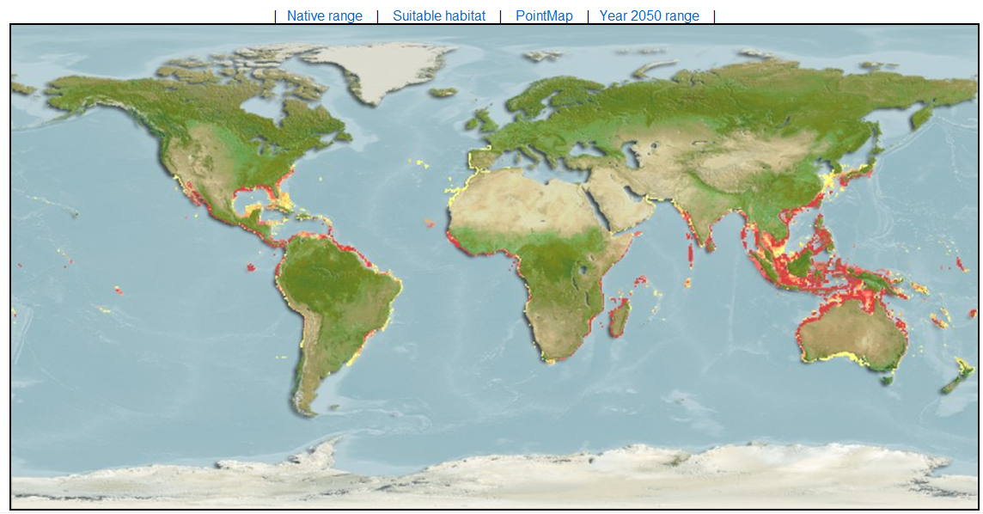
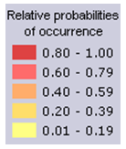
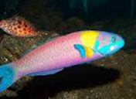
Following dispersal species colonize new areas: Geographical Range
Environment alone does not explain species ranges
Species: Thalassoma lucasanum
Name: Grasse

Slide 14
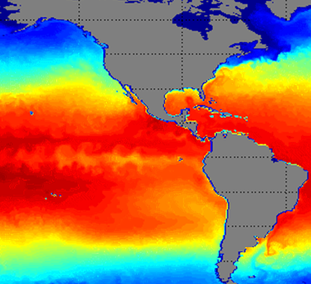
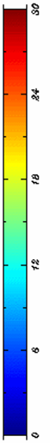
What affects the Geographical range: The environment
Another more specific example: Temperature
Species: Thalassoma lucasanum
Name: Grasse
Tolerance: 16 ºC
Ranges appear to be constrained by something else other than temperature

Slide 15
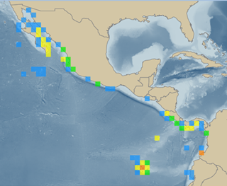
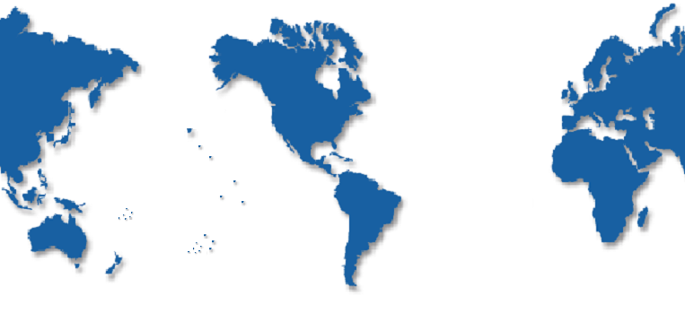
Why a species has the range it does?: Transport
Transport
Gaylord & Gaines, American Naturalist 2000
California
Current
Atlantic
Ocean
Pacific
Ocean
Why it is not here?
Indian
Ocean
Peruvian
Current
Species: Thalassoma lucasanum, Name: Grasse, Tolerance: 16 C
Currents explains well why some species are not found in certain places

Slide 16
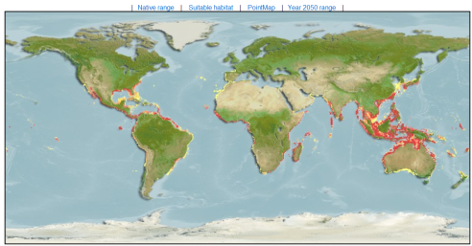
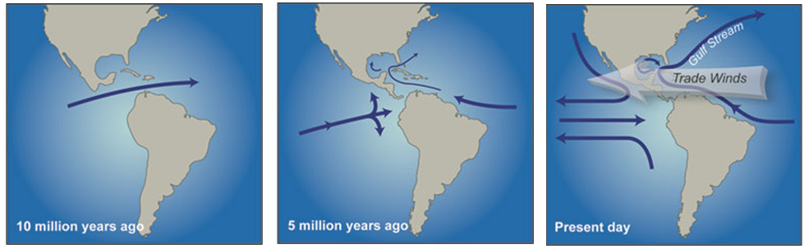
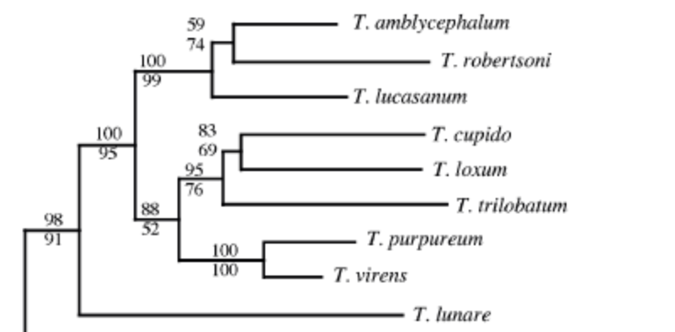
Why a species has the range it does?: evolution
Species: Thalassoma lucasanum, Name: Grasse
Evolution explains well why some species are not found in certain places
~3 million years ago
Bernardi et al Marine Biology 2004

Slide 17
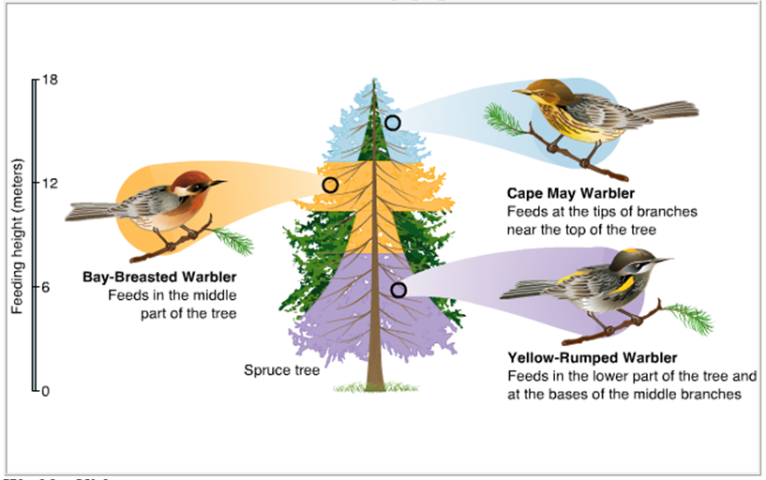
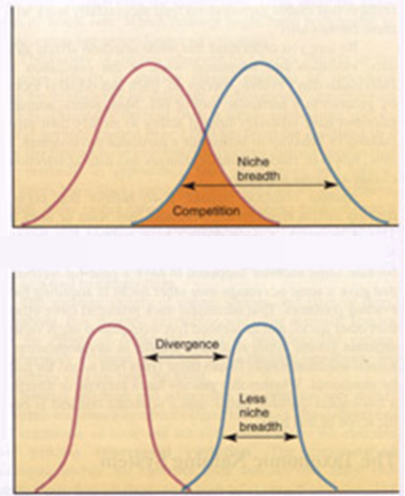
Why a species has the range it does?: niche theory
Ecological factors
Abundance
Resource gradient
While ecological interactions may explain local distribution of species, there is little evidence supporting that ecological interactions set species range boundaries
The struggle for survival forces species to co-exists one way or another

Slide 18
Now, image all those processes acting independently in many places on many species….
…the result….
Millions upon millions of species

Slide 19
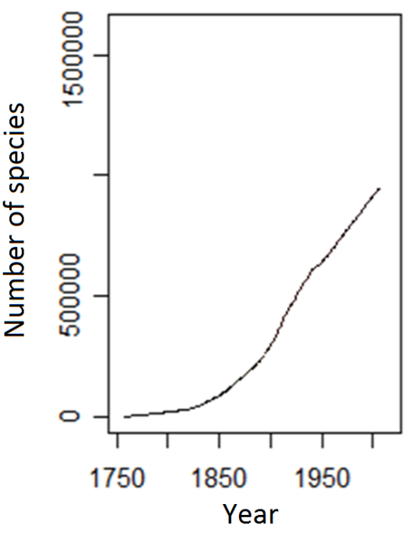
But how many species are there?:
Direct count
Directly we do not even know how many species have been described
Mora et al., Plos Biology 2011

Slide 20
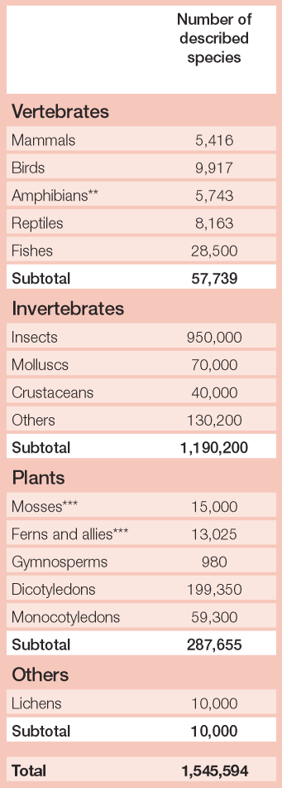
Baillie et al 2004, 2004 IUCN report

Slide 21
But how many species are there?:
Indirect count
Expert opinions
May (Science 2010),….”I think there are 3 to 100 million species”

Slide 22
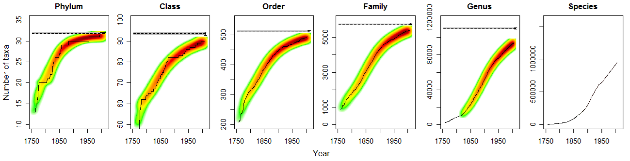
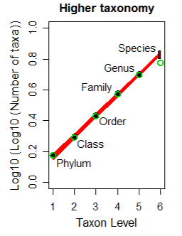
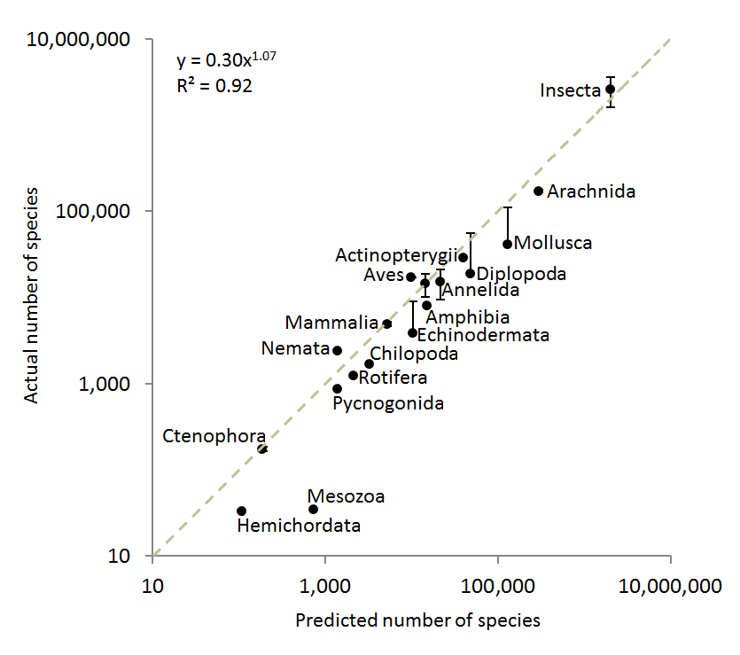
But how many species are there?:
Indirect count
Higher taxonomy
Mora et al. PlosBiology 2011

Slide 23
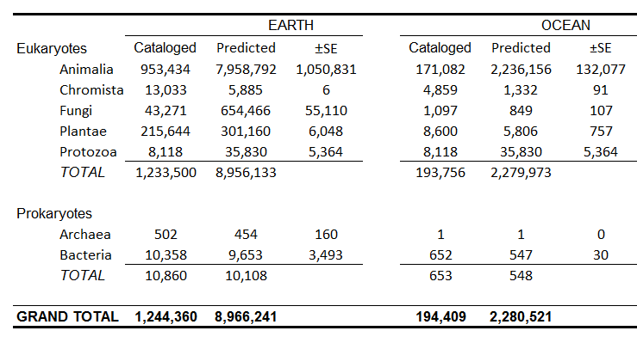
So how many species are there on Earth?
Implications
In average, 6,200 species have been described per year in the last 20 year…
so describing the remaining species could take up to 1,200 years
The average cost of describing an species is estimated at US$48,000…
so describing the remaining species could cost up to US$ 364 billions
In average a taxonomist describes 24.8 species in his/her life…
so describing the remaining species would require 303,000 taxonomists
Mora et al. PlosBiology 2011
Notes:
It is clear that filling this gap will not be easy

Slide 24
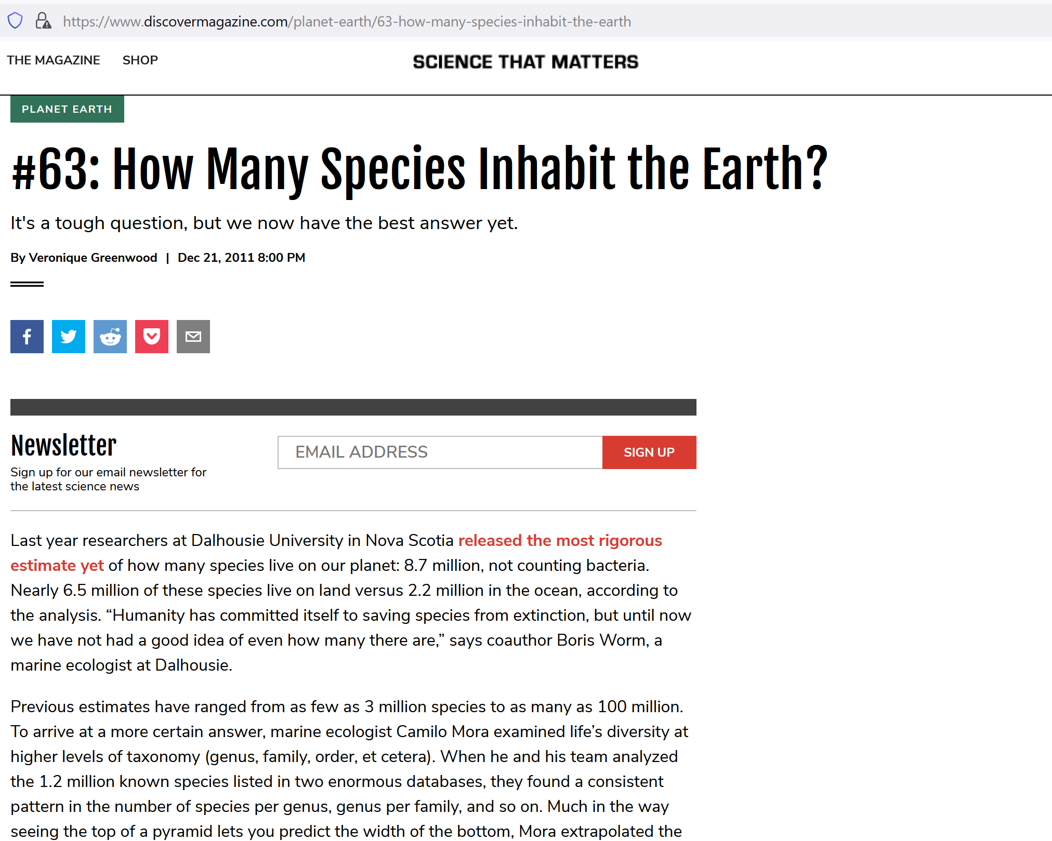
But how many species are there?:
Mora et al., Plos Biology 2011
https://journals.plos.org/plosbiology/article?id=10.1371/journal.pbio.1001127

Slide 25
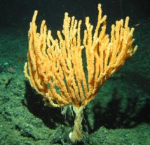
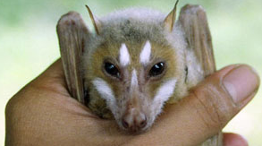
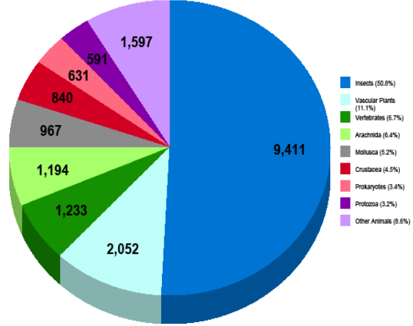
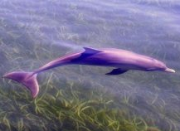
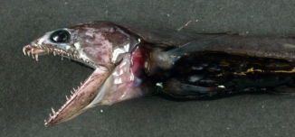
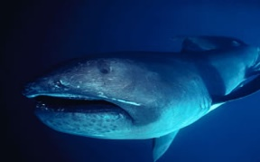
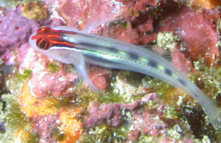
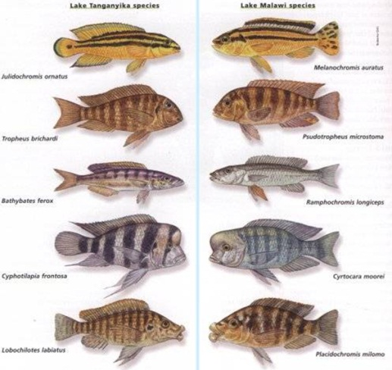
So how many species are there?
Answer: Nobody knows with certainty yet; but,
1) new species just keep poring in.
~17.000 new species were discovered in 2006 alone
Marine Terrestrial
Other animals
Protozoa
Prokaryotes
Crustacea
Pretty Ugly
Mollusca
Insects
Arachnida
Vertebrates
Large Small
Plants
SOS (State of Observed species 2007)
2) Many species are hard to differentiate and similar looking things may turn up to be different species.
So, perhaps we will never know…

Slide 26
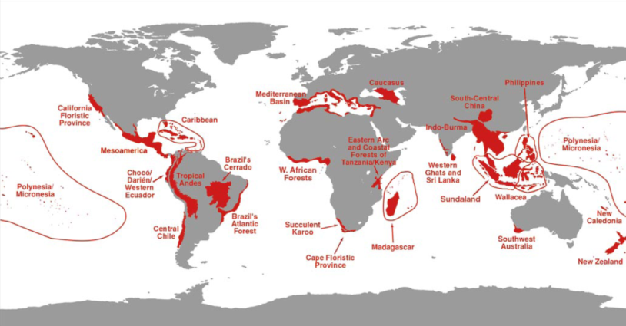
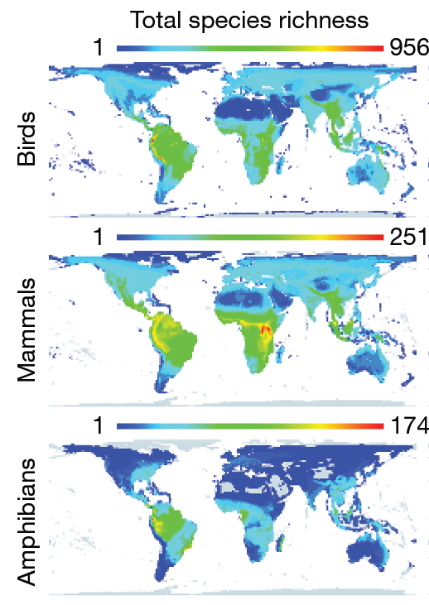
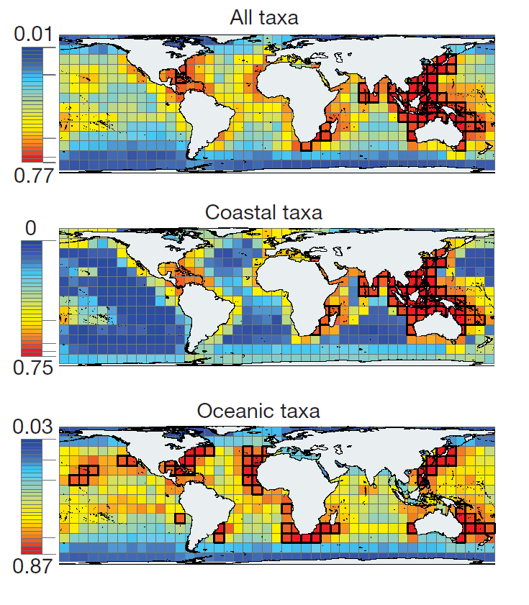
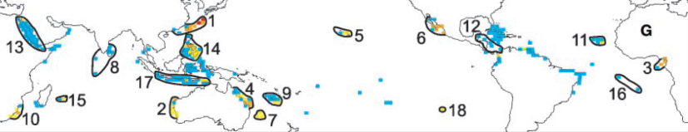
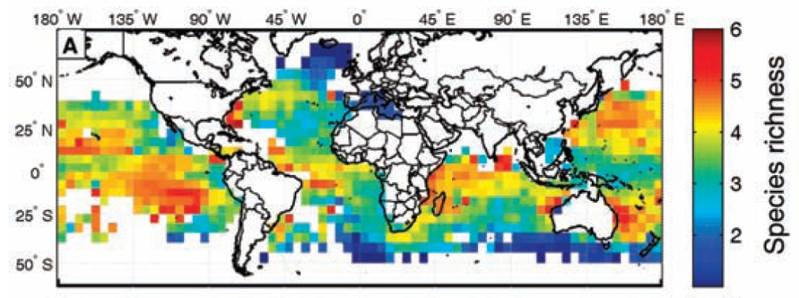
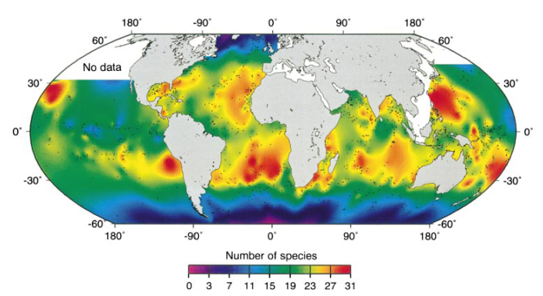
…overlapping of ranges create global diversity patterns: mostly in the tropics…
About 10.000 species of vertebrates
About 20.000 species of vertebrates
About 13.000 species of Eukaryotes
Myers et al, Nature 2000
SO WHERE ARE THE REMAINING 8 MILLION SPECIES WE THINK EXISTS!
About 1.000 species of animals
Grenyer et al, Nature 2007
Roberts et al, Science 2002
Tittensor et al, Nature 2010
About 40 species of fish
About 30 species of foraminifera
Worms et al, Nature 2005
Ruthenford et al, Nature 1996
Notes:
We are now working on anwsering this question using novel statistics and comprihensive databases.

Slide 27
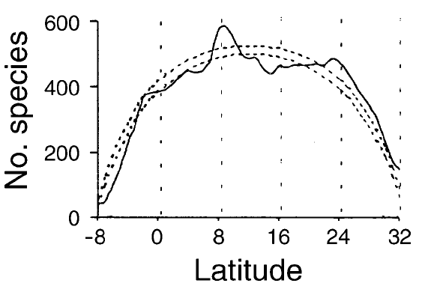
Where is biodiversity: THE PATTERNS
If we assume everything is correct, it seems that in general species are found on the tropics more so than in other places
Fishes
Mora & Robertson (Ecology 2005)

Slide 28
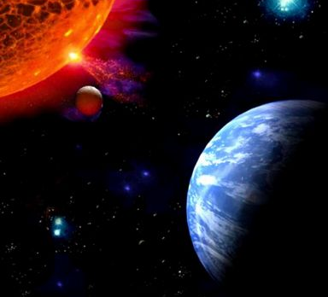
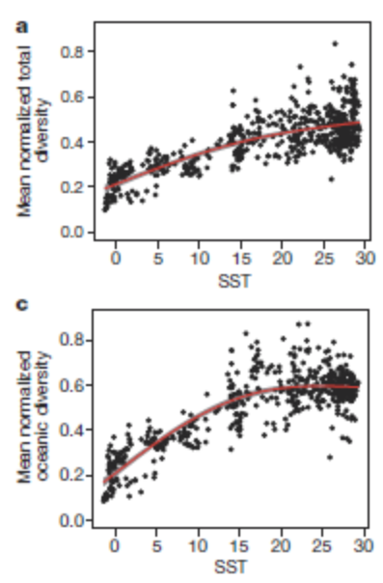
Why in the tropics?: THE MECHANISMS ARE NOT CLEAR
A CASE STUDY WITH THE TEMPERATURE HYPOTHESIS
Tittensor et al, Nature 2011

Slide 29
Why species are where they are?: THE MECHANISMS ARE NOT CLEAR…TEMPERATURE
“more individuals hypothesis”
more energy more individuals more species
“physiological tolerance hypothesis”
Temperature–richness relationships
More species survive under warm than cold conditions
“speciation rate hypothesis”
faster evolutionary rates or stronger biotic interactions increase the opportunity for evolutionary diversification in hot regions
Currie et al (Ecol. Let. 2004)

Slide 30
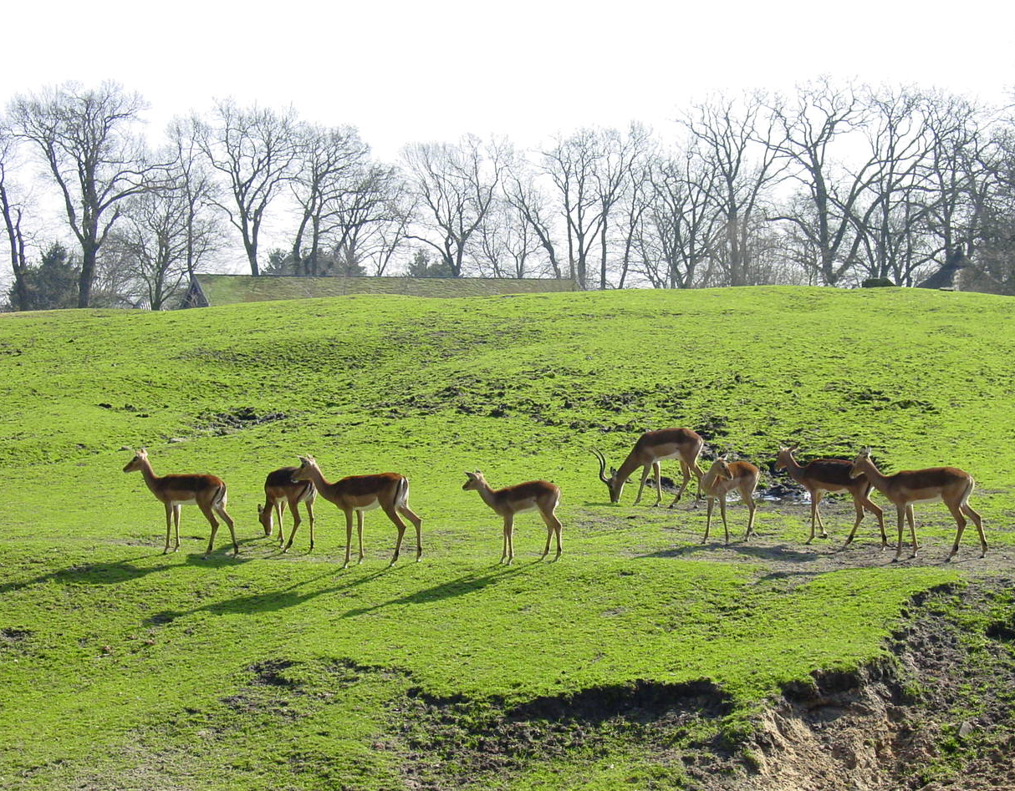
Species vary in their abundances
Output of individuals
Mortality
Migration
Input of individuals
Natality
Immigration

Slide 31
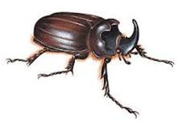

Most species are rare
Species abundance distributions
In most natural communities, most species are represented by one or few individuals
“Most species are rare”, Andrewartha & Birch, Book 1954
Magurran, Book 2004

Slide 32
Species abundance distributions: why skewed?
Niche partitioning
A
B
C
D
E
MacArthur , PNAS 1957: “stick fragment”
Resource
Sequential subdivision of a resource causes progressively smaller populations

Slide 33

Most species are small

Slide 34



Larger species are at higher latitudes
The latitudinal gradient in body size
Or Bergmann’s Rule
Energy requirements
Energy availability

Slide 35

Why a species has the body size it does?
Optimum trade-off
Cost
Ecological /
Evolutionary
forces
Benefit
Body size

Slide 36

Larger species are at colder temperatures: Bergmann's rule
Body size increases with colder temperatures
A lower area/mass ratio helps to conserve heat which is very adaptable in cool temperature
2
Mass=8
Area=24
Area/Mass=3
2
2
Roberts DF (1978) Climate and human variability
1
Mass=1
Area=6
Area/Mass=6
A higher area/mass ratio helps to dissipate heat which is very adaptable in warm temperature
1
1

Slide 37
In summary
There are over 8.7 million different forms of life on Earth (Species)
Most species are in the tropics
Life is very unique to our planet ...and...
It took a while to develop
Most species are rare
Most species are small

